Slide 1
Ni-Cu-PGE(platinoids) deposits

Slide 2
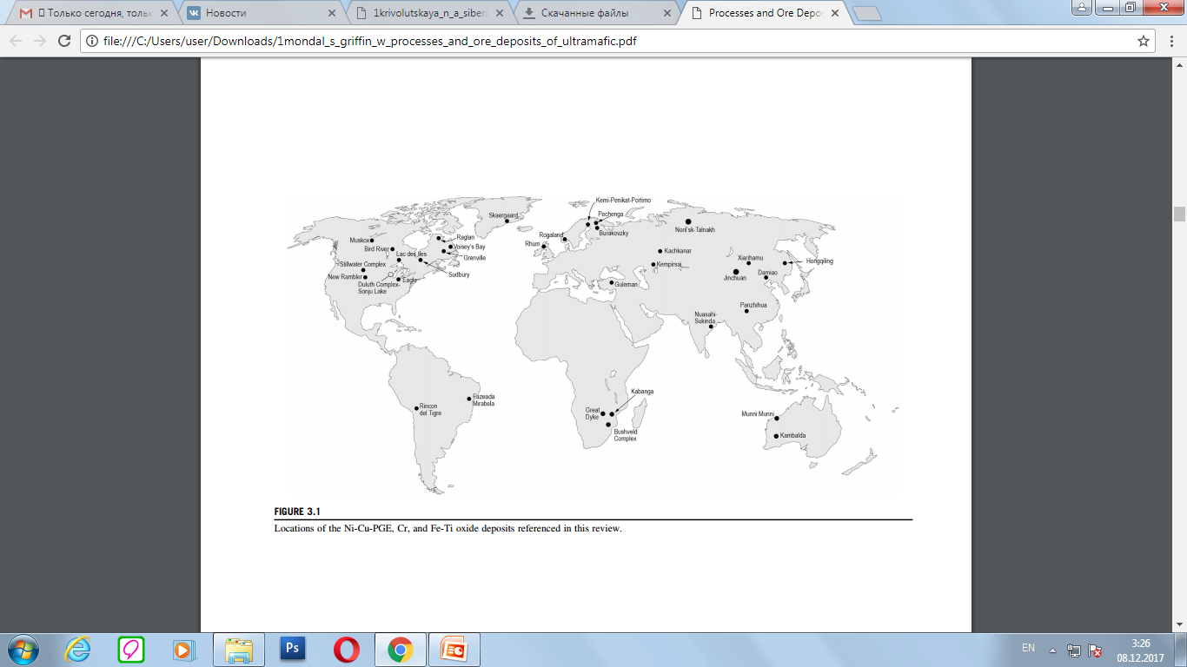
Locations of the Ni-Cu-PGE, Cr, and Fe-Ti oxide deposits

Slide 3
Ni-Cu-PGE deposits
Several types of sulfide-rich Ni-Cu-PGE deposits exist, with virtually all characterized by sulfide assemblages composed principally of pyrrhotite, chalcopyrite, pentlandite, 6 cubanite or pyrite. Textures of mineralization include finely-disseminated sulfide minerals, sulfide globules, nettextured assemblages where interstices between silicate minerals are rich in sulfides, and massive sulfide accumulations. Ore tonnage and grade may vary greatly (Fig. 2). Komatiite-hosted mineralization is typically mined for Ni only, and is found near the base of lava flows or within spatially associated subvolcanic intrusive rocks. Low- to intermediate-tonnage deposits are associated with small intrusions that are part of magma conduit systems. These ore types are exploited for Ni, Cu, Co, and variable amounts of PGEs. Examples include Voisey’s Bay, Eagle, Tamarack, Xiarihamu, and several other small occurrences in China. Mineralized sills in the Noril’sk district of Siberia and in the Alxa district of Gansu Province, China are also interpreted as magma conduits but the tonnage of the deposits is large (Fig. 2). Disseminated sulfide mineralization that occurs near the base of composite intrusions includes deposits of the Duluth Complex and the Platreef of the Bushveld Complex. The large-tonnage deposits of the world-famous Sudbury Intrusive Complex represent the sole example of massive sulfide accumulations in embayments and fractures beneath an impact-produced melt sheet. Fig. 3 from Maier (2005) summarizes the relative stratigraphic positions of both Ni-Cu-rich and PGE-rich deposits.

Slide 4
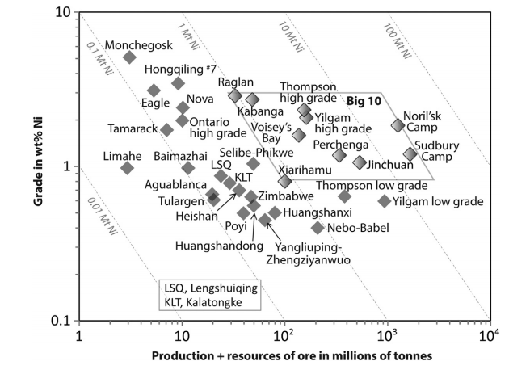
Figure 2. Grade and tonnage of several Ni deposits

Slide 5
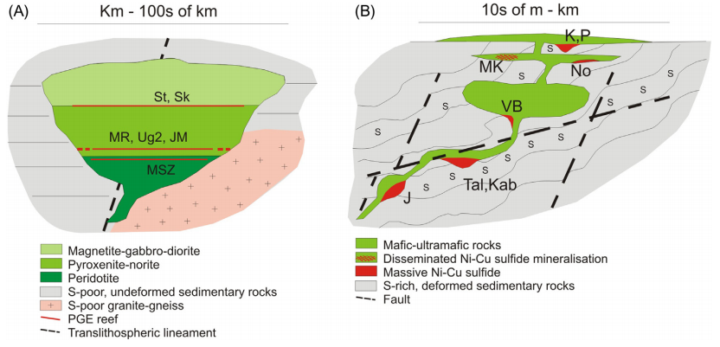
Figure 3. Schematic representation of PGE-rich reefs in layered intrusions (A) and Ni-Cu-PGE deposits in conduits (B)

Slide 6
Ni-Cu-PGE deposits
Sulfide mineralization associated with komatiites may be massive or may fill interstices between spinifex olivine plates. Troughs below komatiite flows attest to the elevated temperatures of the Mg-rich magma flows and the process of thermomechanical erosion. Lesher and Keays (2002) state that large extrusive komatiite-associated Ni-Cu-PGE deposits occur at or near the bases of volcanic cycles in which the lower komatiite flows are thicker, more magnesian, more channelized and commonly intercalated with metasedimentary rocks. Fig. 3 from Lesher (2007) illustrates the occurrence of massive sulfides at the base of komatiite flows in contact with pelitic rocks in the Raglan district of Quebec.

Slide 7
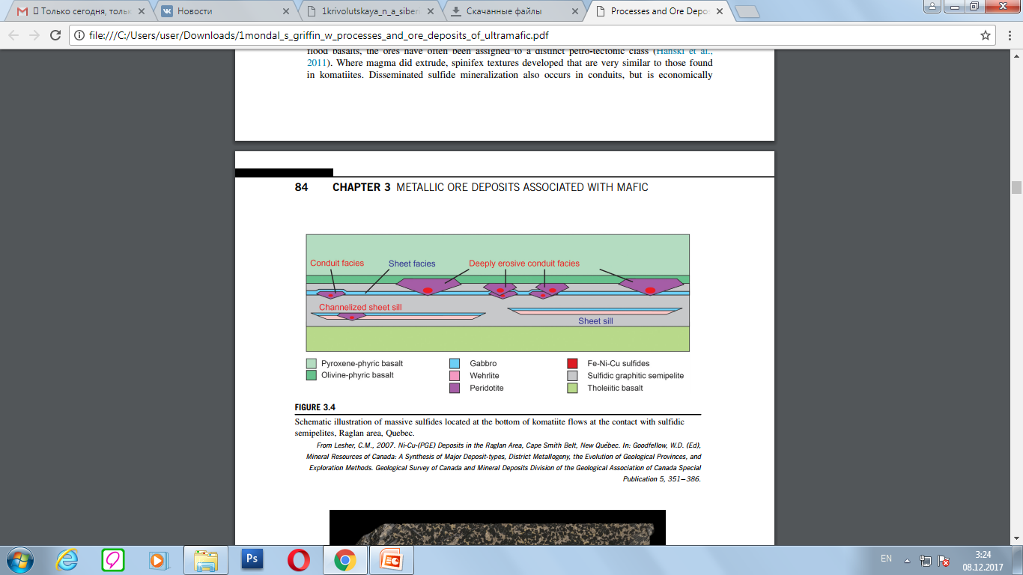
Schematic illustration of massive sulfides located at the bottom of komatiite flows at the contact with sulfidic semipelites, Raglan area, Quebec

Slide 8
The Noril’sk deposit
The Pt–Cu–Ni Noril’sk deposits were discovered in the nineteenth century on the SW Siberian Platform. They are located in a paleorift zone and display a structure that differs from that of the Siberian craton basement. Terrigenous and carbonate rocks with anhydrite and coal are exposed on the surface of the Noril’sk area. They are overlapped by volcanic rocks of the trap formation. The stratigraphy of the sediments and tuff–lava deposits is given. The intrusive rocks consist of 10 % plutonic rocks and are represented by ultrabasic to basic intrusions (sills, dykes) of mostly normal alkalinity and rarely of elevated alkalinity. There are two types of sulfi de ores: disseminated and massive. These are located near the contact of intrusion with surrounding rocks. There are three main deposits in the Noril’sk area: the Talnakh, Oktyabr’skoe, and Noril’sk deposits. Many other intrusions contain mineralizations in economic quantities.

Slide 9
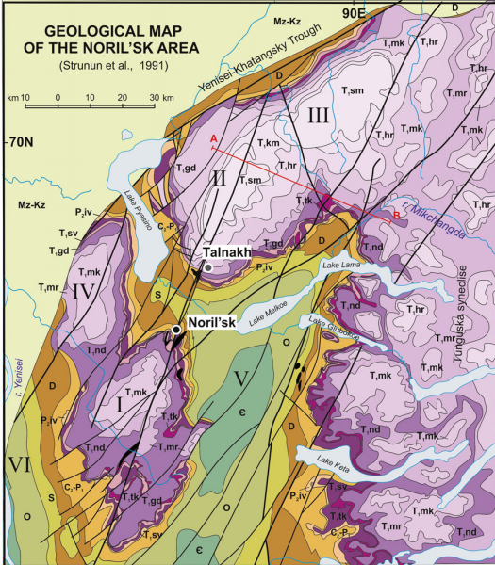
Fig. 4 Geological map of the Noril’sk area Modifi ed after Geological map… 1994 Depressions: I—Noril’sk, II—Kharaelakhsky, III—Kumginsky; IV—Yeniseysky; Swells: V—Khantaysko-Rybninsky, VI—Dudinsky; AB—vertical section line; 1–2—faults: 1—Noril’sk- Kharaelakh, 2—Lamsko-Letninsky

Slide 10
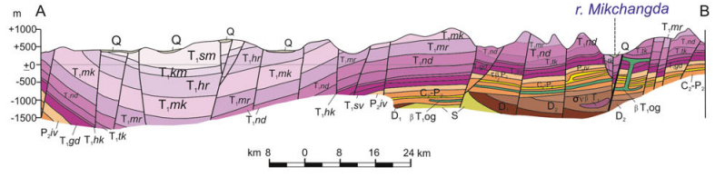
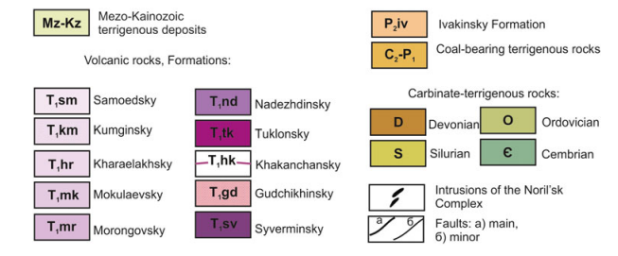
Fig. 4 (continued)

Slide 11
Rocks of the Noril’sk Deposits
The platform cover in the Noril’sk region has a two-part structure and is more than 12 km thick. No basement rocks are exposed anywhere in the Noril’sk area (Geology and ore… 1994 ), and the nature of these rocks can be inferred from fragments of muscovite leucogranites found in the Early Triassic pyroclastic material occurring 20 km south of Noril’sk, with these fragments dated at 1,700–2,200 Ma. Early Proterozoic (?) sedimentary–volcanic and molasse- like rocks from the Riphean folded structural fl oor, low- grade metamorphosed terrigenous-carbonate and volcanic rocks from the Riphean structural fl oor, and molasse-like rocks from the Early Vendian fl oor that were deformed into gently dipping folds were recovered by boreholes in some blocks.

Slide 12
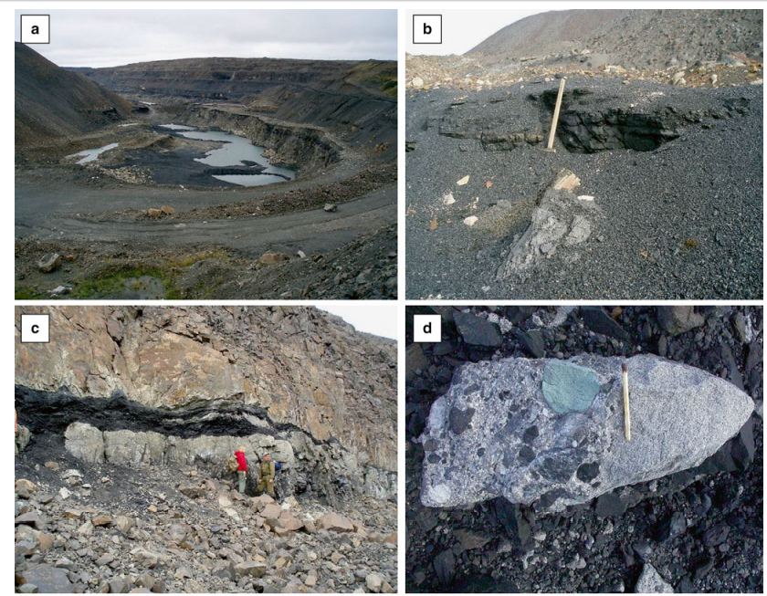
Photos of the Tunguska Group rocks ( a ) coal open pit “KUR 2,” ( b ) main coal horizon, ( c ) coal horizon between two basalt fl ows of the Ivakinsky Formation (“Plast Zametny”), ( d ) interlayering of conglomerates and sandstones

Slide 13
Ores of the Noril’sk Deposits
The Noril’sk deposits contain ores of two types: PGE–Cu–Ni sulfi de and PGE low sulfi de. The latter are hosted in the upper portions of the massifs, in the leucogabbro, the magmatic breccia, and occasionally the picritic gabbro-dolerite units. These ores are typical of the Noril’sk 1 deposit (Sluzhenikin et al. 1994 ). The sulfi de ores are contained in the contact zone of the intrusion and the host rocks from the lower contact zone (Geology and ore… 1994 ; Sluzhenikin et al. 2014 ), although they were also found in the upper inner and outer-contact zones (Oktyabr’skoe deposit). The ores come in two types: disseminated and massive, which occur in both the intrusions and the host rocks. An unusual feature of the mineral deposits in the Noril’sk area is the inconsistency between the thicknesses of the intrusions and related ores: the volume of the ores can consist 15 % of the intrusions’ volume; the thickness of massive ores can rich up to 54 m (Likhachev 1996 ). Given the low sulfur solubility in basaltic melts near the depths corresponding to those of the emplacement and crystallization of the intrusions in the Noril’sk Complex, it is hard to imagine how so much sulfur could be mobilized only from the parental magma that produced the intrusive bodies.

Slide 14
Ores of the Noril’sk Deposits
The mineralogy of the ores was documented in much detail by many researchers (Sukhanova 1968 ; Genkin 1968 ; Genkin et al. 1981 ; Distler et al. 1988 , 1999 ; Komarova et al. 2002 ; Sluzhenikin et al. 2014 et ctr.). The major minerals are pyrrhotite (hexagonal and monoclinic pyrrhotite and troilite), pentlandite, and chalcopyrite-group minerals, which often compose individual ore types and were discovered at the Talnakh deposits by A.A. Filimonova (talnakhite, putoranite, and Ni-bearing putoranite). The Noril’sk ores are distinguished for their great diversity of rare minerals, which have never been found at any other Cu–Ni deposits, and the huge size of PGM. Studies of these ores and the discovery of new minerals in them were contributed by A.D. Genkin (six new minerals), T.L. Evstigneeva (four new minerals), A.A. Filimoniva, V.A. Kovalenker, and other researchers (see Chap. 4).
The three largest currently developed deposits in the Noril’sk district are Oktyabr’skoe, Talnakh, and Noril’sk 1.

Slide 15
Thank you for attention

